Slide 2
Phylogeny
Mikael Lenz Strube (milst@dtu.dk)

Slide 3
How are bacteria related
Did you find a new species?
Does your new bacteria look like something we know?
Did you find a bacteria that can do something cool, but looks like something from earlier?

Slide 4
How are bacteria related
Taxonomy
Is one or the other
Names & categories
Changes often
Phylogeny
Relatedness
Depends highly on methods
16S
WGS

Slide 5
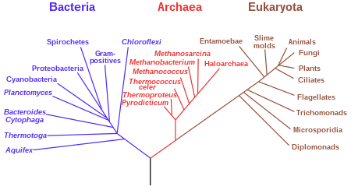
The phylogenetic tree

Slide 6
The phylogenetic tree
Is a way to visualize (genetic) relatedness
The distance between leaves is comparable to the difference between organisms (genomes)
Usually, these trees are made on a single gene or a couple of housekeeping genes
We will use a data driven approach and use as much of the genome that we can

Slide 7
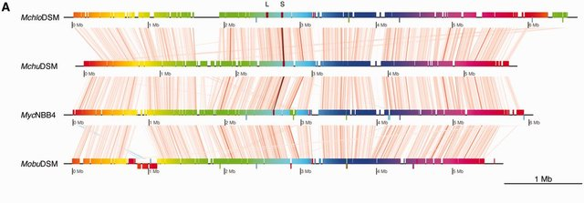
The phylogenetic tree
We will use ROARY which will:
Compare all the proteins of all the genomes to find the genes that are conserved
Fish out the nucleotide sequence of these proteins and build sequences of these
Align these sequences across all genomes
We then build a tree from this alignment separatly

Slide 8
The phylogenetic tree
The basic logic is based on a distance matrix, e.g. what are the number of mismatches in the pairwise alignment
The tree is then based on this distance matrix, making things
with little distance close and vice versa
Modern tree builders are far more complex
Modern tree builders also take a shortcuts to speed up computation
It is usually good practice to add an outlier genome
AGCTCGC
AGCACCT
ACCACCT
 | AGCTCGC | AGCACCT | ACCACCT
AGCTCGC | 0 | 3 | 4
AGCACCT | 3 | 0 | 1
ACCACCT | 4 | 1 | 0

Slide 9
The phylogenetic tree
The phylogeny is usually not interesting in itself
Does the phylogeny match some outside parameter?
Can you add some of the data you have generated to your phylogenetic tree?

Slide 10
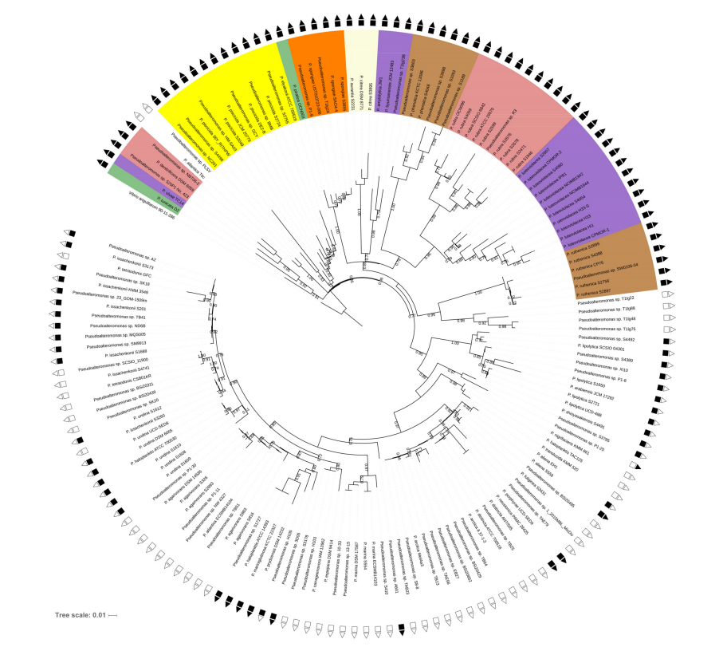
The phylogenetic tree
Phylogeny matches both color, BGC arsenal
and carbohydrate utilization of Pseudoalteromonas
Paulsen SS, Strube ML, Bech PK, Gram L, Sonnenschein EC. 2019. Marine Chitinolytic Pseudoalteromonas Represents an Untapped Reservoir of Bioactive Potential. mSystems 4:1–12.

Slide 11
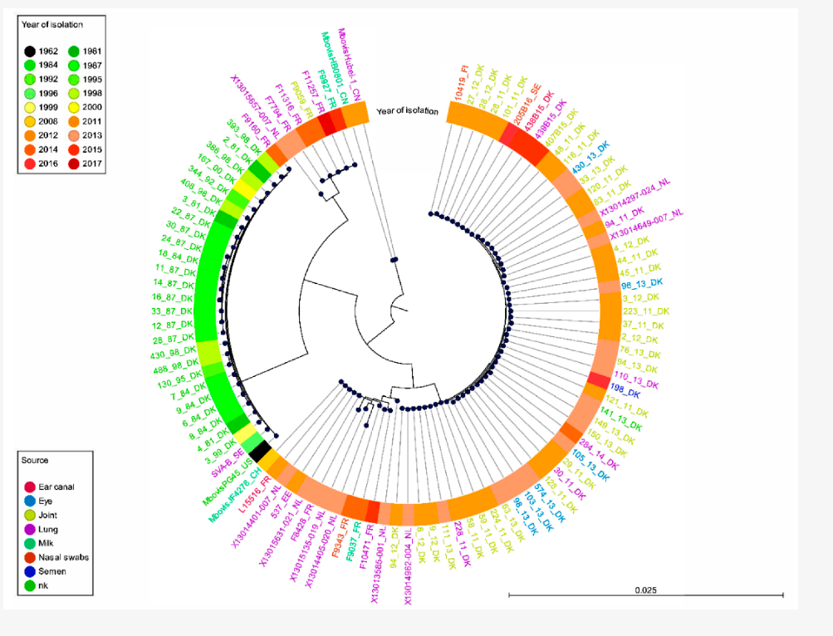
The phylogenetic tree
The Mycoplasma infecting european cows developed around 2010 and is highly reduced in genomic size
Tardy F, Aspan A, Autio T, Ridley A, Tricot A, Colin A, Pohjanvirta T, Smid B, Harders F, Lindegaard M, Lauritsen KT, Lyhs U, Wisselink HJ, Strube ML. 2020. Mycoplasma bovis in nordic european countries: Emergence and dominance of a new clone. Pathogens 9:1–15

Slide 12
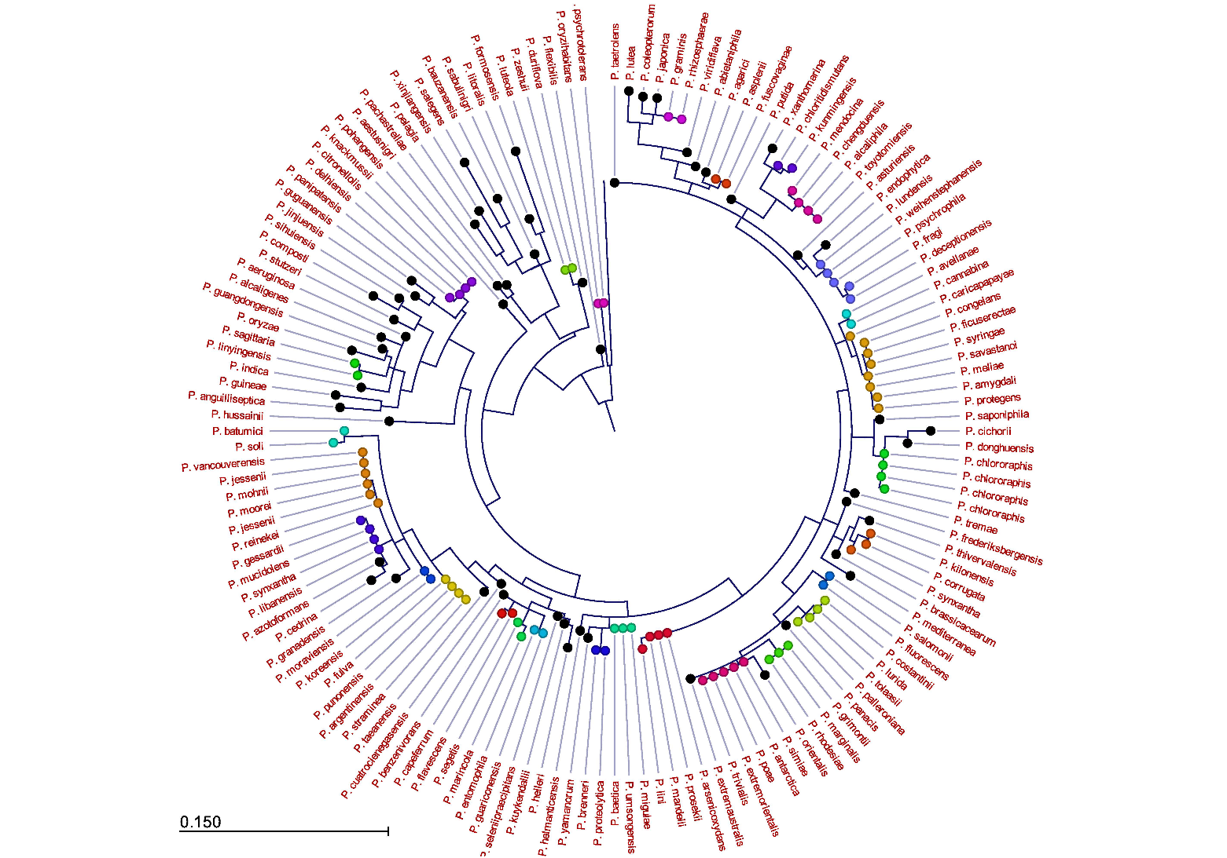
The phylogenetic tree
The 16S gene cannot be used for phylogeny in Pseudomonas
Lauritsen JG, Hansen ML, Bech PK, Jelsbak L, Gram L, Strube ML. 2021. Identification and Differentiation of Pseudomonas Species in Field Samples Using an rpoD Amplicon Sequencing Methodology. mSystems 6:e00704-21.

Slide 13
The phylogenetic tree
Exercise 6
Build your own whole genome phylogeny
See if you can make a nice visualization of it
If you are done early, you can try with your own favorite bacteria!

